Slide 1
Bitcoin Price Prediction
(Algorithm Track)
Course: CMPE 255
Prof: Kaikai Liu
Team:
Prerna Garsole (016015831)
Pranav Chandra Kallepalli (016587064)
Farazuddin Mohammad (016176836)

Slide 2
Objective
Bitcoin(BTC) is a decentralized digital currency that can be transferred on the peer-to-peer bitcoin network. BTC transactions are verified by network nodes through cryptography and recorded in public distributed ledger called blockchain.
The accurate prediction of bitcoin price can not only provide decision support for investors but also provide reference for the government to formulate regulatory policies.
Our aim is to perform Exploratory Data Analysis on the Bitcoin Prices Data and build, develop and test models to perform price prediction.

Slide 3

Bitcoin Business Understanding
Bitcoin is a cryptocurrency, a digital asset designed to work as a medium of exchange.
Bitcoin is a virtual currency designed to act as money and a form of payment outside the control of any one person, group, or entity, thus removing the need for third-party involvement in financial transactions.
Bitcoin was introduced to the public in 2009

Slide 4
Data Description
Date: date of the record (Sequential Data) (Feature Variable).
Open: the opening price, the price at which an asset, in this case, Bitcoin, trades at the beginning of the day. (USD) (Feature Variable).
High: the maximum price of the day, the highest price reached by Bitcoin on that day, (USD) (Feature Variable).
Low: the minimum price of the day, the lowest price reached by the Bitcoin on that day, (USD) (Feature Variable).
Close: the closing price, the price at which Bitcoin trades at the end of the day, (USD) (Target Variable).
Volume: the sum of actual trades made during the day, (USD)(Feature Variable).
Market Cap: market capitalization, the total value of all shares of a company(Feature Variable).

Slide 5
Data set features
Variable Name | Variable Description | Data type
Time | Date and Time of observation | Date
Volume | Sum total trades taking place | Number
Open | Opening price on the given day | Number
High | Highest price on the given day | Number
Low | Lowest price on the given day | Number
Close | Closing price on the given day | Number

Slide 6
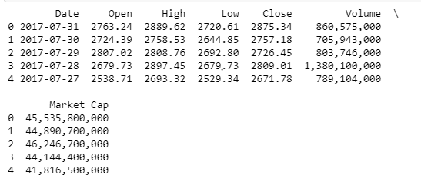
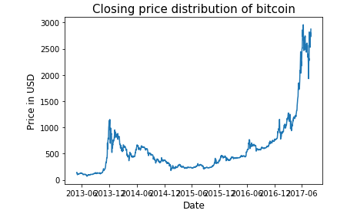
Data set features
Target Variable Plot
Sample Input Data

Slide 7
Real Application
BTC and other Cryptocurrency price prediction models can help full-time, occasional crypto investors to decide whether to invest in the particular crypto currency or not.
We can perform data mining on how Socio-political issues like Wars, Pandemics have caused fluctuations in the Prices of Cryptocurrencies.

Slide 8
Models Tested
Statistical Models
Auto Regressive Model Time Series data set
Moving Average Model Time Series data set
Auto Regressive Integrated Moving Average Time series data set
KNN Model to predict the closing price using the Trends from other Major Cryptocurrency
Random Forest to predict the closing price using the Trends from other Major Cryptocurrency
Gradient Boosting to predict the closing price using the Trends from other Major Cryptocurrency
LSTM(Long Short Term Memory)

Slide 9
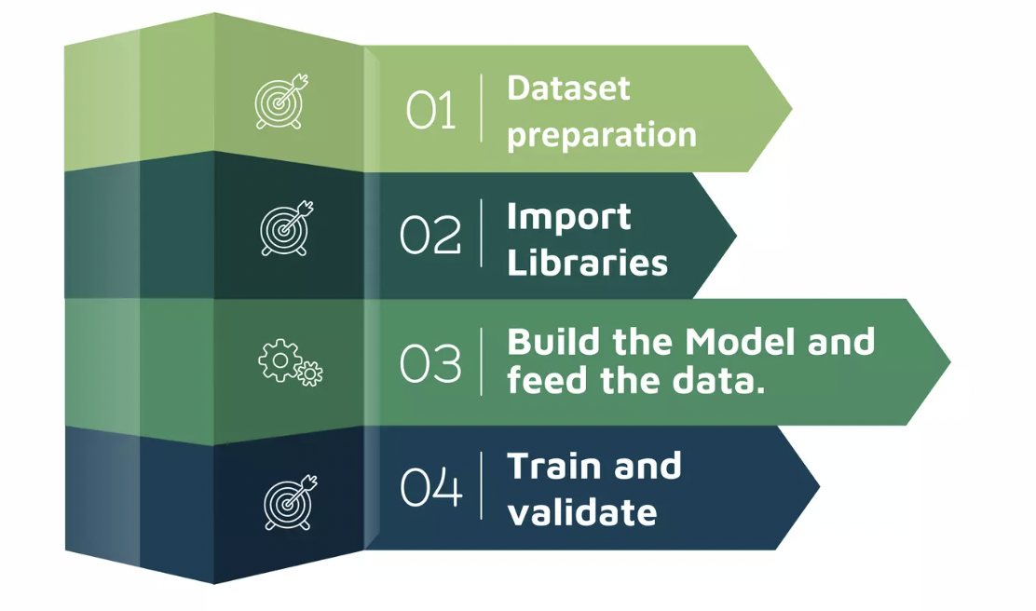
Model Implementation

Slide 10
Statistical Models Comparison
The Data instances are not linearly independent of each other so the Linear Regression model can’t be used for prediction.
The data does not obey stationarity as well (can be claimed visually), we need to apply suitable transformations and then test the MA and AR models for prediction.
Note conditions for stationarity are as follows:
Mean remains constant throughout the sequence
Standard deviation is constant throughout the sequence.
There is no notable seasonality
We used the one-root test also known as the the augmented Dicky Fullter Test for checking stationarity.

Slide 11
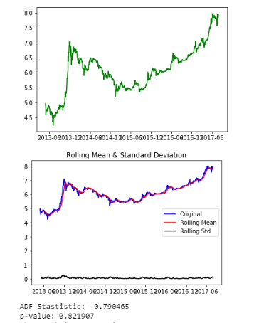
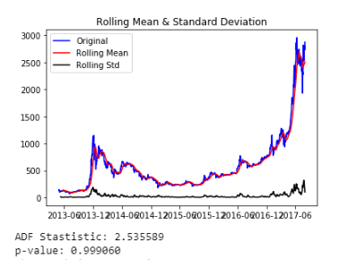
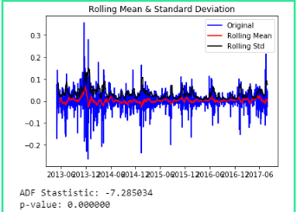
Stationarity Transformation
Original Data
Log Transformed
After Differencing

Slide 12
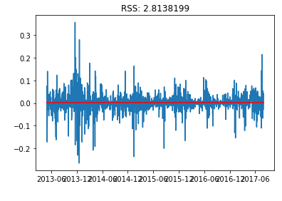
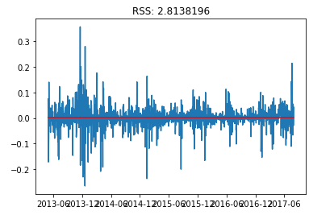
AR Model and MA Model Performance

Slide 13
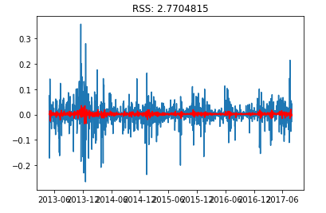
Auto Regressive Integrated Moving Average Model (ARIMA)

Slide 14
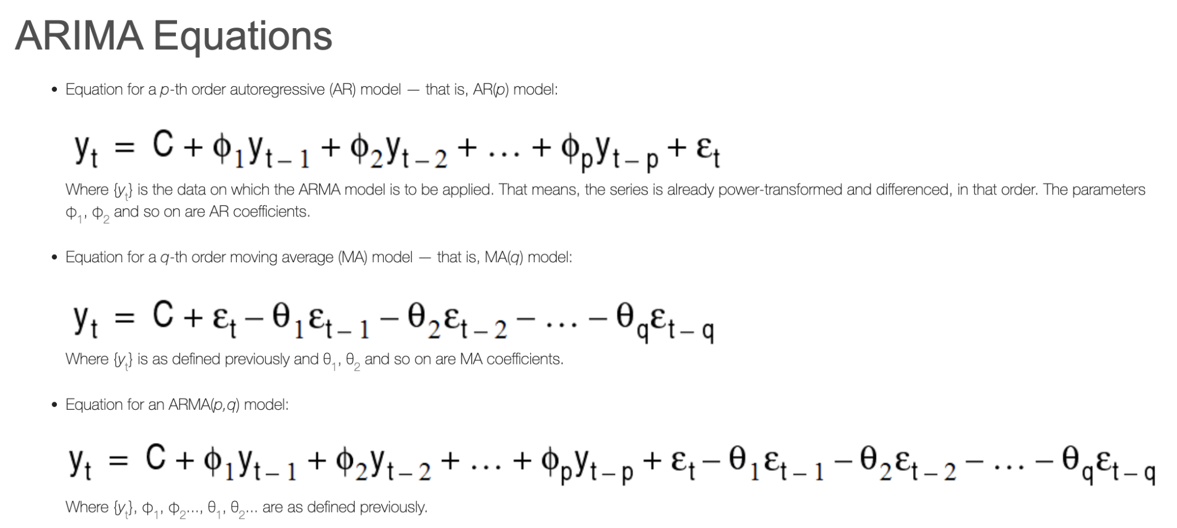
Math in ARIMA

Slide 15
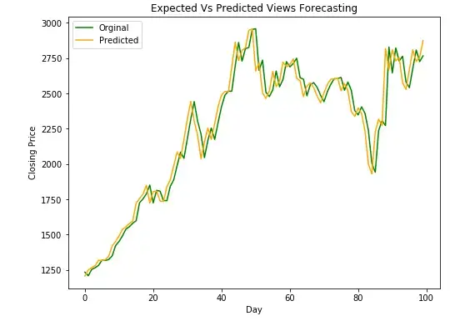
ARIMA for Prediction
Mean Error in Predicting Test Case Articles : 3.593133 %

Slide 16
LSTM
The name of LSTM refers to the analogy that a standard RNN has both "long-term memory" and "short-term memory".
The LSTM architecture aims to provide a short-term memory for RNN that can last thousands of timesteps, thus "long short-term memory".
A common LSTM unit is composed of a cell, an input gate, an output gate and a forget gate.

Slide 17
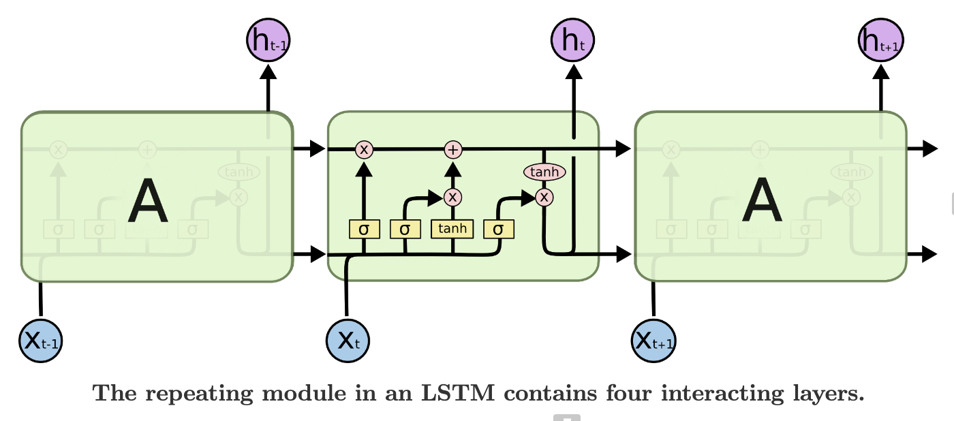
Architecture of LSTM

Slide 18
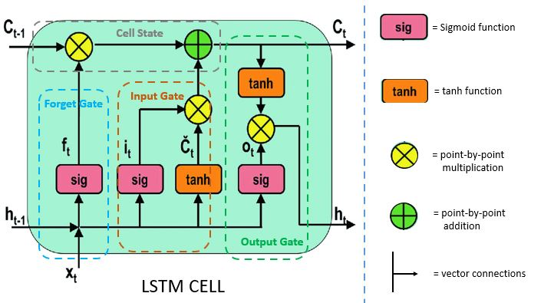
Gates of LSTM

Slide 19
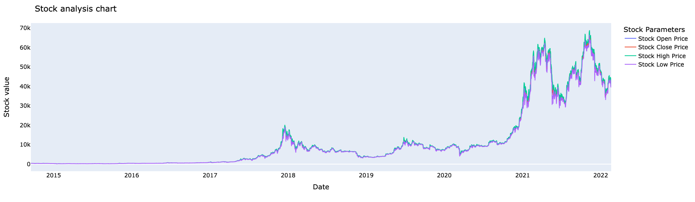
Stock Prices of BTC over the past years

Slide 20
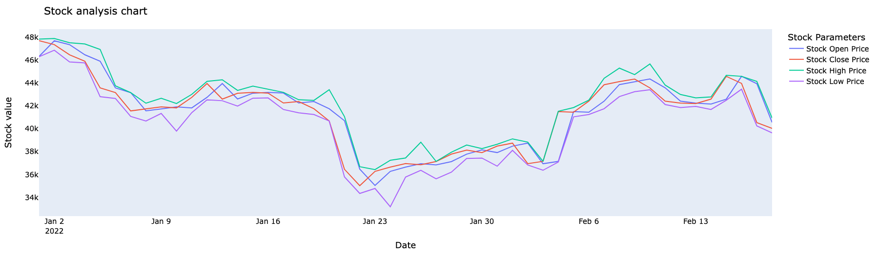
Stock Price of BTC for this year start

Slide 21
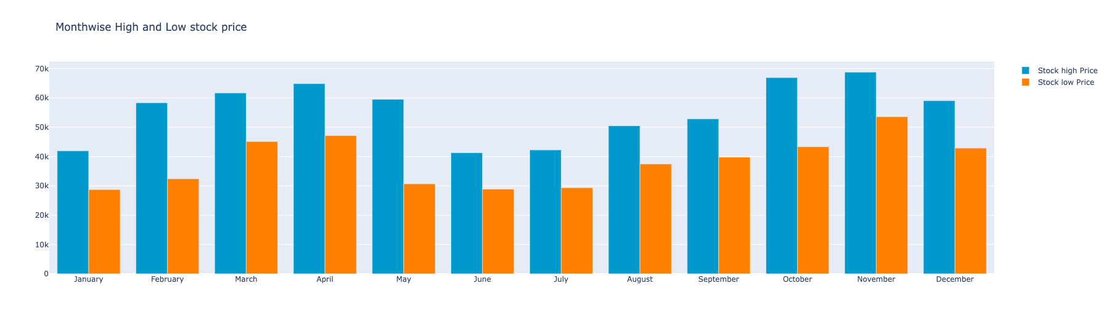
Bitcoin prices high and low for year 2021

Slide 22
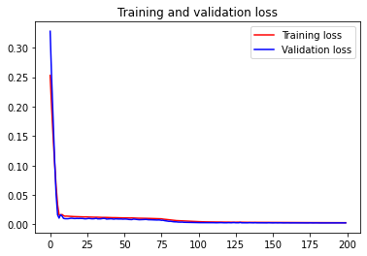
Loss comparison
After 200 epochs the train loss was 0.0028 and test loss was 0.0025

Slide 23
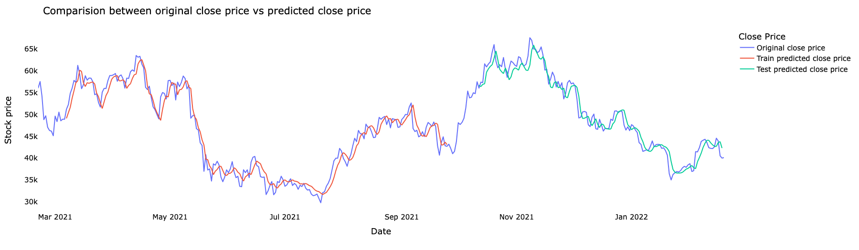
Stock Price on train and test data

Slide 24
Evaluation using metrics
explained variance regression score:
Train: 0.953
Test: 0.957
Mean Gamma deviance regression loss:
Train: 0.0020
Test: 0.0014
R2-Score:
Train: 0.953
Test: 0.956

Slide 25
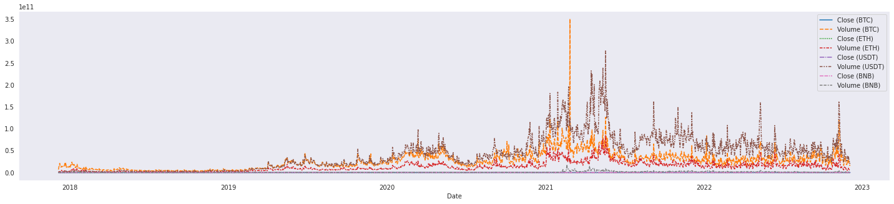




BTC Prediction Using Trends from other Cryptocurrencies

Slide 26
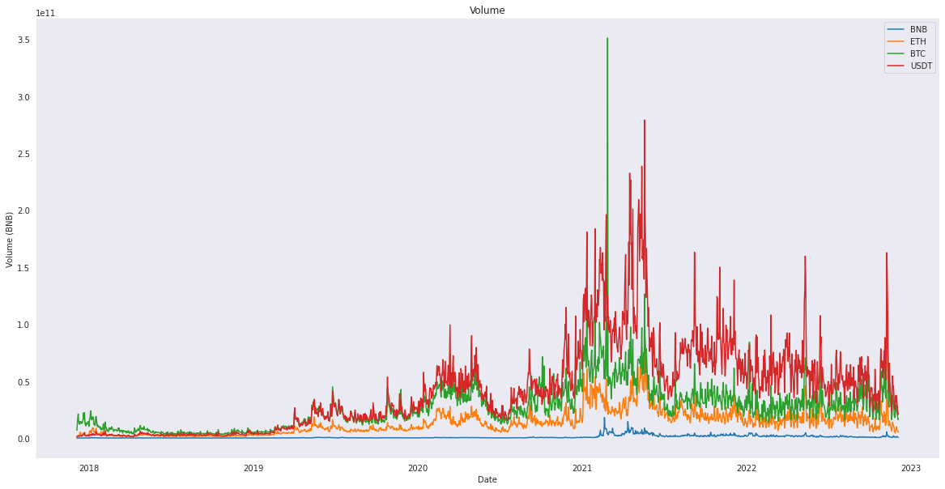

Slide 27
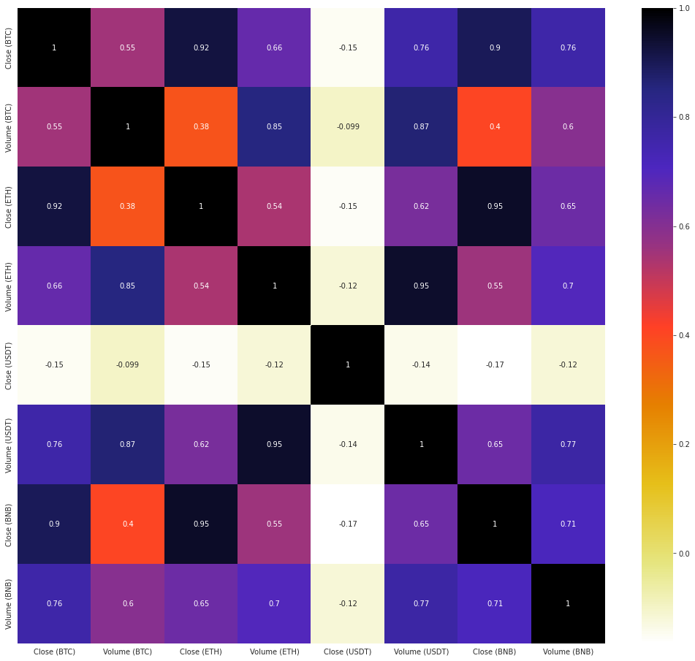
Correlation Matrix Plot

Slide 28
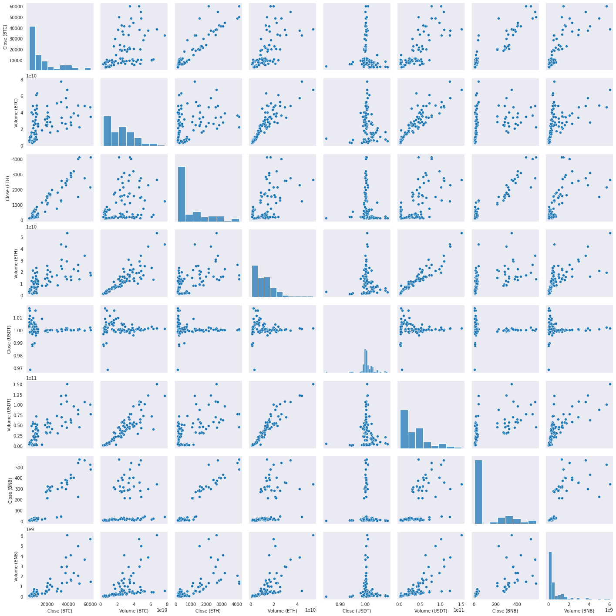
Feature wise Scatter Plot

Slide 29
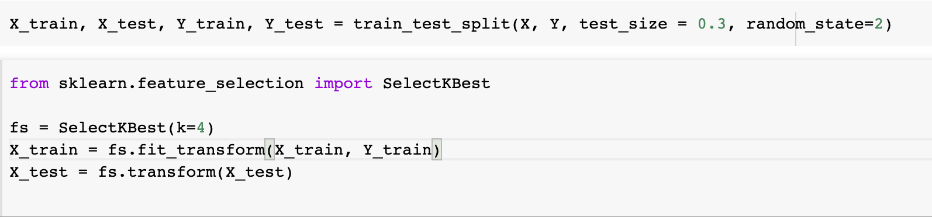
Best Feature Selection using SelectKBest API
['Close (ETH)', 'Volume (USDT)', 'Close (BNB)', 'Volume (BNB)']

Slide 30
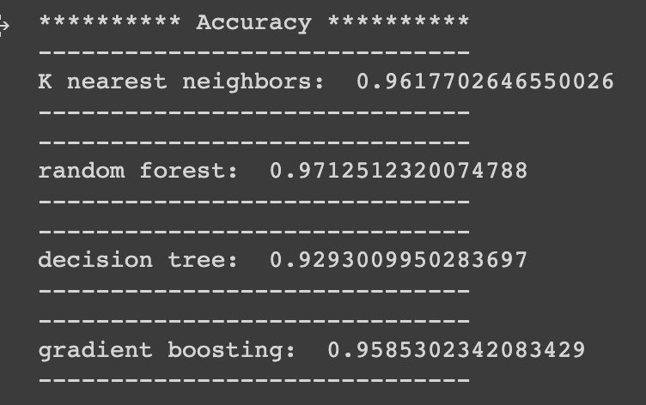
Models Tested to predict Clos BTC
Random Forest Classifier has the best notable performance

Slide 31
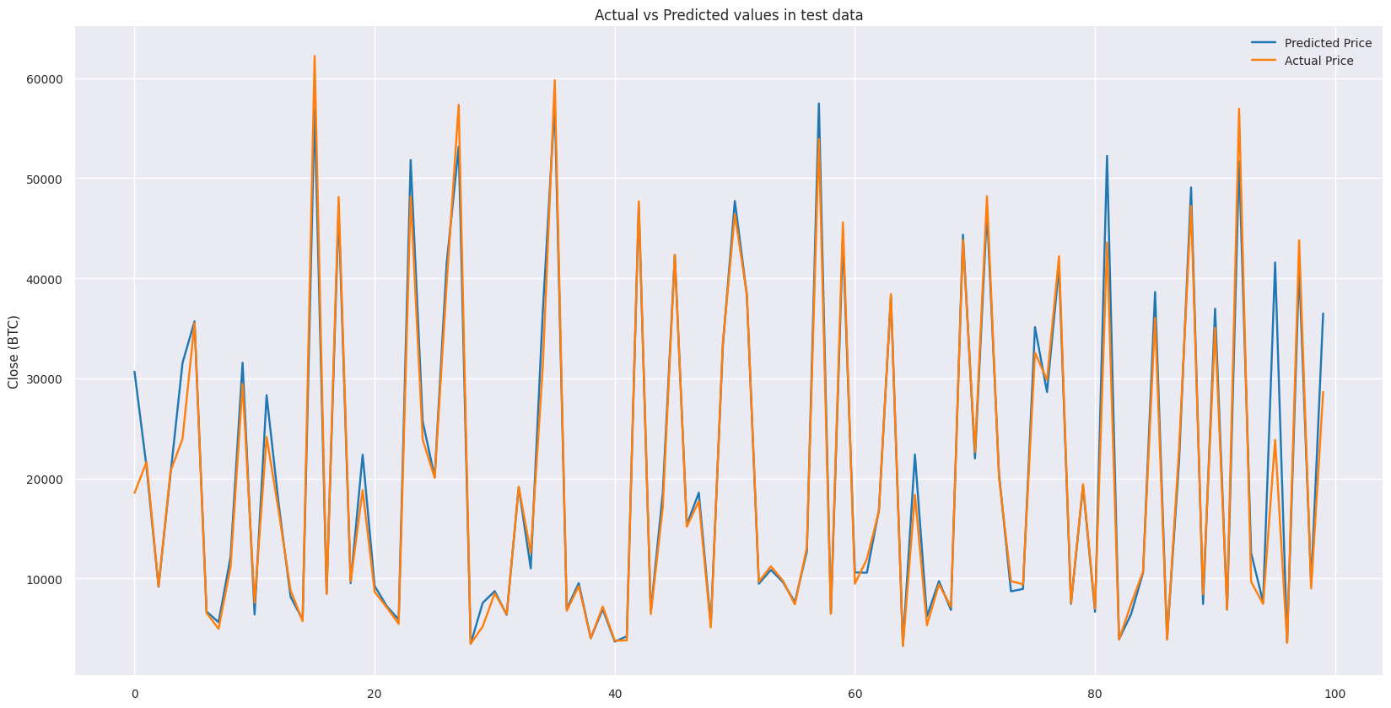
Random Forest Regressor

Slide 32
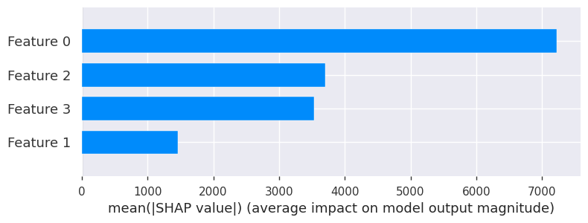
Model Explainability Using SHAP (plot-1)
['Close (ETH)', 'Volume (USDT)', 'Close (BNB)', 'Volume (BNB)']

Slide 33
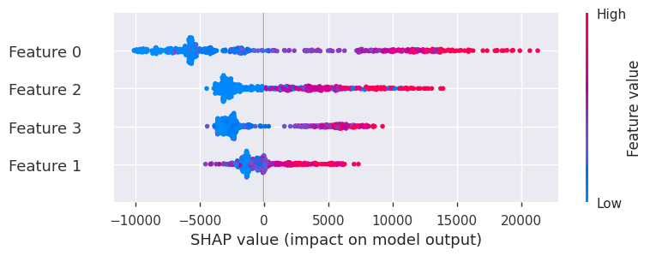
Model Explainability Using SHAP (plot-2)
['Close (ETH)', 'Volume (USDT)', 'Close (BNB)', 'Volume (BNB)']

Slide 34
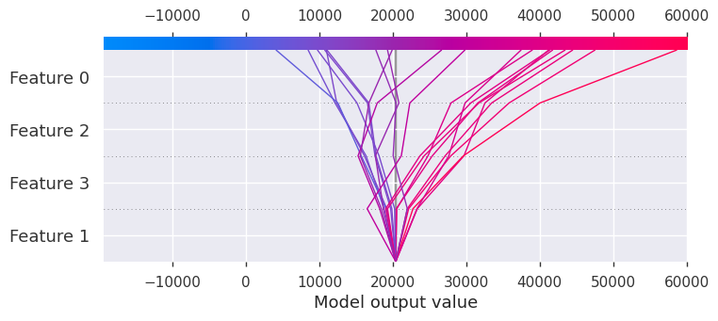
Model Explainability Using SHAP (plot-2)
['Close (ETH)', 'Volume (USDT)', 'Close (BNB)', 'Volume (BNB)']

Slide 35
Conclusion
Performed EDA to Observe Trends in features used int BTC Price Prediction.
Built and Tested the following models
Statistical Models: Auto Regression, Moving Average and ARIMA
KNN
Gradient Boosting Regression
Decision Tree Regressor
Random Forest Regression
LSTM
Added Model Explainability using Shap API.

Slide 36
Future Work
Doing Hyperparameter tuning on the ensemble models to get better performance.
Adding confidence data based on the expert suggestion to tweak the model in live conditions can be useful.
Adding Acceleration component for faster training and performance Boost.

Slide 37
References
[1] Shengao Zhang, Mengze Li, Chunxiao Yan, "The Empirical Analysis of Bitcoin Price Prediction Based on Deep Learning Integration Method", Computational Intelligence and Neuroscience, vol. 2022, Article ID 1265837, 9 pages, 2022. https://doi.org/10.1155/2022/1265837
Statistical models: https://towardsdatascience.com/bitcoin-price-prediction-using-time-series-forecasting-9f468f7174d3
https://medium.com/geekculture/lstm-for-bitcoin-prediction-in-python-6e2ea7b1e4e4

Slide 38
Thank You!

